Slide 1
Principle Of Cryptography: Symmetric key & Public Key
The prefix “crypt” means “hidden” and suffix “graphy” means “writing”.
It is technique of securing information and communications through use of codes so that only those person for whom the information is intended can understand it and process it.
In Cryptography the techniques which are use to protect information are obtained from mathematical concepts and a set of rule based calculations known as algorithms to convert messages in ways that make it hard to decode it.

Slide 2
Techniques used For Cryptography:
Encryption
Decryption

Slide 3
Encryption and Decryption
Data Encryption is a method of preserving data confidentiality by transforming it into ciphertext, which can only be decoded using a unique decryption key produced at the time of the encryption or prior to it.
Decryption is the process of converting ciphertext back to plaintext.

Slide 4
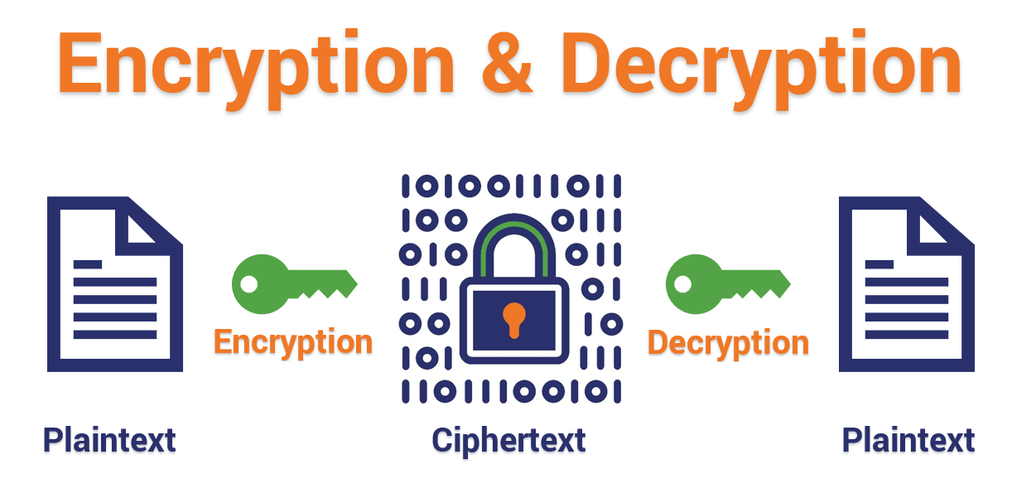
Figure1: Encryption & Decryption process

Slide 5
Types of Cryptography
Asymmetric Cryptography
Symmetric Cryptography

Slide 6
1. Asymmetric Cryptography(public Key)
This type of cryptography is known as “public-key” encryption.
Anyone who has access to such a public communication will be unable to decode or read it.
It is used in the majority of internet security protocols.

Slide 7
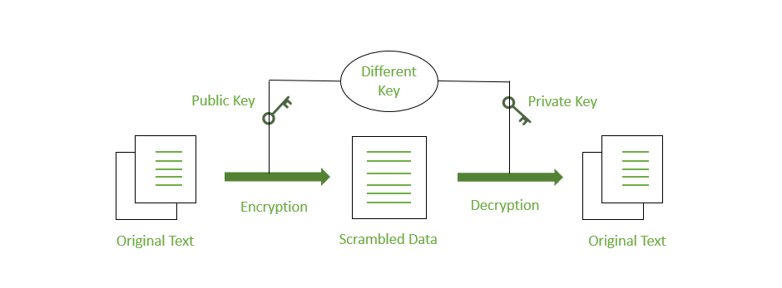
Figure2: Asymmetric Key

Slide 8
2. Symmetric Cryptography(Private Key)
This type of cryptography is known as “private-key” encryption.
In Symmetric Cryptography, it uses a single key to encrypt and decrypt a message.
The sender encrypts the plaintext message using the key and sends it to the recipient who then uses the same key to decrypt it and unlock the original plaintext message.

Slide 9

Figure3: Symmetric Key

